Slide 1


Casey Khan
Capstone Walk Through
Mortality Predictor & Mental Health Assistance

Slide 2




Our mission
Ranked 7th of the Fortune 500
$332.885B FY20 revenue
A diversified enterprise with complementary but distinct business platforms
Health Benefits
Health Services
OUR MISSION
Helping people live healthier lives and helping make the health system work better for everyone
OUR VALUES
Integrity | Compassion | Relationships | Innovation | Performance

Slide 3
Introduction
Background
Goals for the course
20 years of technology experience
Over 10 years of Product Management
Launched over 10 products
Entrepreneur
Education
MBA
BS in Computer Science
AIPMM Product Manager
Systems Engineer
Passion
Healthcare Technology Products
Domains
Healthcare
P&C
Goals
Learn Data Science to
Launch DS based products
Personal Growth
NOT the Goal
Become a data scientist
Passion
Healthcare Technology Products
Business Insider Track
DoD/DHS
Mass Transit

Slide 4
Capstone Overviews
Closely related to work projects & natural interest
Data access need to test internal models
Interest from disease imputation
Physician Burnout project
Mortality Predictions
Mental Health Survey Analysis

Slide 5
Process
Problem Identification
Data Wrangling
Modeling
Documentation
Exploratory Data Analysis
Preprocessing & Data Development

Slide 6
MIMIC
Mortality Predictor

Slide 7
MIMIC-III
Medical Information Mart for Intensive Care (MIMIC iii)
Beth Israel Deaconess Medical Center
Over 40K patients between 2001 to 2012
Completely deidentified

Slide 8
Purpose Motivation
Motivation
Disease Imputation Project
Optum Data Science Team
Get Access for research
Follow on projects
Re-admission
Disease imputation
Model testing

Slide 9
Data Acquisition
CITI Registration
Register for Course
Complete Course
Apply to PhysioNet
Provided Organization information
Provided supervisor approval
Reference check with supervisor
Time consuming
MIMIC DB
CITI: Collaborative Institutional Training Initiative

Slide 10
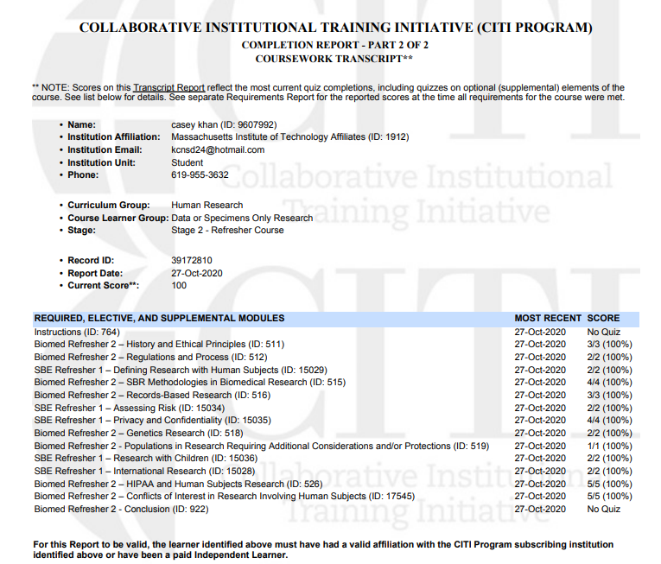
CITI Course Details

Slide 11

Certification of completion
Verify at: https://www.citiprogram.org/verify/?wdaa12831-082f-468d-ae23-cfbf79ffa343-39172810

Slide 12
Issues with project
Not enough time to get
Corporate permission for running existing model
Intellectual property issues
Required to execute NDA at a minimum
Laptop not able to accommodate the volume
Couldn’t use Chart Events
Simplified to mortality predictions

Slide 13
Data Management
Downloaded as double zipped file
6.6 GB
Comprised of 26 individual zip files
Project Files
ADMISSIONS | ICUSTAYS
CALLOUT | INPUTEVENTS_CV
CAREGIVERS | INPUTEVENTS_MV
CHARTEVENTS | LABEVENTS
CPTEVENTS | MICROBIOLOGYEVENTS
DATETIMEEVENTS | NOTEEVENTS
DIAGNOSES_ICD | OUTPUTEVENTS
DRGCODES | PATIENTS
D_CPT | PRESCRIPTIONS
D_ICD_DIAGNOSES | PROCEDUREEVENTS_MV
D_ICD_PROCEDURES | PROCEDURES_ICD
D_ITEMS | SERVICES
D_LABITEMS | TRANSFERS

Slide 14
Data Management
Loading All files
Loading Chart Events

Slide 15
Data Cleaning
Cleaned Data
Using Two files for analysis
ADMISSIONS
PATIENTS

Slide 16
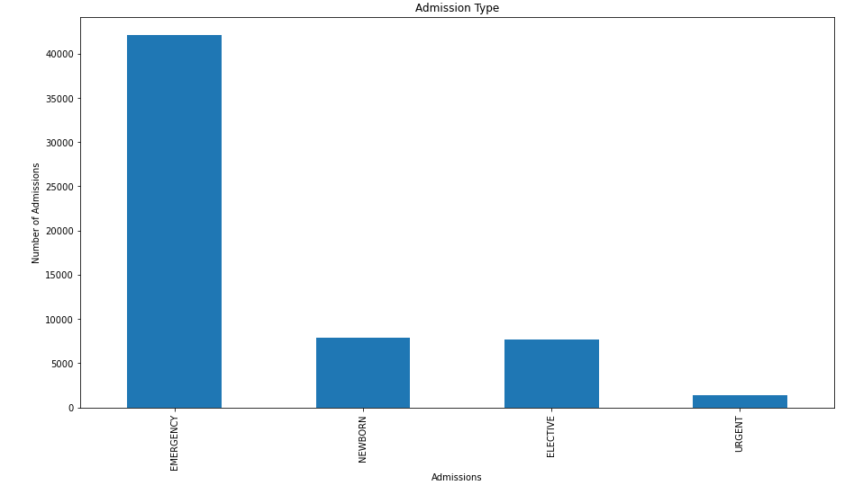
Exploratory Data Analysis – Admission Type
Most Expensive but most often utilized

Slide 17
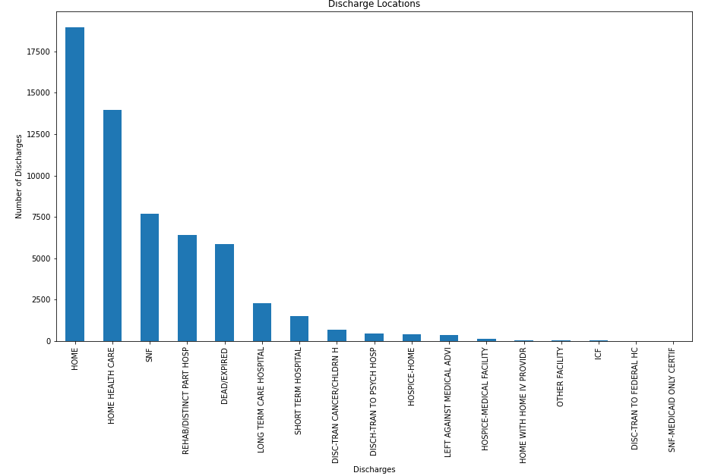
Exploratory Data Analysis – 2 Discharge Locations
How many should have been to PAC or SNF (need re-admission logic) for further analysis

Slide 18
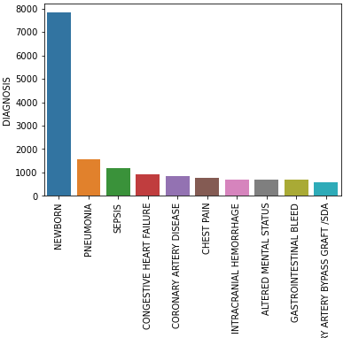
Exploratory Data Analysis – 3 Diagnosis Code
15,691 Unique Diagnosis
4 of the top 10 Diagnosis are heart related (Pre COVID-Data, would be interested to investigate if heart disease is the most preplant disease in an acute care facility)
Newborn
Pneumonia
Sepsis
Congestive Heart Failure
Coronary Artery Disease
Chest Pain
Intracranial Hemorrhage
Altered Mental Status
Gastrointestinal Bleed
Coronary Artery Disease\ Coronary Artery Bypass Graft

Slide 19
Feature Selection
Admission Type
Diagnosis
Gender
Admit

Slide 20
Modeling
Gradient Boosted
n_esitmators=300
learning_rate= .5
max_features=30
max_depth=10
random_state=0
Model
Logistic Regression
class_weight = balanced
Max_iter= 300
Notes:
N_estimators = # of trees in the forest
Learning rate: Step size at each iteration while moving towards a minimum loss function. If the too big, it can jump over the minimum. If too small it will learn at slow rate or get undersidable minimal
Max features: number of features when looking for best split.
Max depth:This indicates how deep the built tree can be. The deeper the tree, the more splits it has ,ranging from 1 to 32 and plot the training and test errors.
Random_state: Controls the random seed given to each Tree estimator at each boosting iteration. In addition, it controls the random permutation of the features at each split (

Slide 21
Evaluation
Gradient Boosted
TN (8063) | FP (1126)
FN (3787) | TP (1768)
Logistic Regression
TN(4491) | FP(4698)
FN(885) | TP(4670)
Metric | Gradient Boosted | Logistic Regression
Accuracy | .667 | .621
Recall (sensitivity) | .60 | .62
Notes:
Precision: TP/TP+FP
Recall or Sensitivity: TP/TP+FN
Specificity: TN/TN+FP
Accuracy: TP+TN/TP+TN+FN+FP
F1: 2TP/2TP+FP+FN
Type1 error: Reject the null hypothesis incorrectly. False positive error
Type 2: A type II error occurs when the null hypothesis is false but not rejected. False –ive error.

Slide 22
Next Steps
Work through re-admission logic
Incorporate chart events
Will need a VM can’t be on a laptop
Break the diagnosis for
Readmission in the 6 months
Mortality by ICD9
Will need ICD9 to ICD10 Conversion
DRG Research need to see impact of HCFA DRG (Healthcare financing administrations)

Slide 23
Mental Health
Consequences of asking for help in Technology jobs

Slide 24
Purpose Motivation
Physician Burnout, Survey related
In technology

Slide 25
Data Acquisition
From Kaggle:
https://www.kaggle.com/osmi/mental-health-in-tech-survey

Slide 26
Data Management
Reading data thru CSV using Pandas

Slide 27
Data Cleaning
Gender no longer binary
Best guess to convert to
Male
Female
Transgender

Slide 28
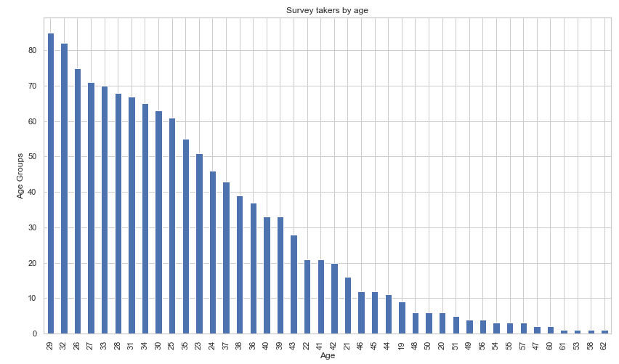
Exploratory Data Analysis 1- By Age
Large number of survey takers are less than 35. Reflecting a young workforces

Slide 29
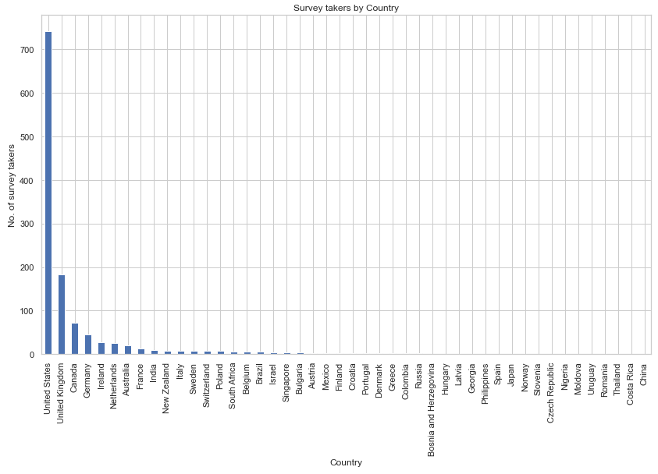
Exploratory Data Analysis 2- By Country
Survey respondents are disproportionally based in the US & UK

Slide 30
Exploratory Data Analysis 1- By Country
Survey respondents are disproportionally based in the US & UK

Slide 31
Exploratory Data Analysis 3- By Country
Survey respondents are disproportionally based in the US & UK

Slide 32
Feature Selection
Age
Gender
Country
family_history
treatment
work_interfere
no_employees
remote_work
tech_company
benefits
care_options
wellness_program
seek_help
anonymity
leave
mental_health_consequence
phys_health_consequence
coworkers
supervisor
mental_health_interview
phys_health_interview
mental_vs_physical

Slide 33
Modeling
Logistic Regression
class_weight = ‘balanced’
max_iter= 300

Slide 34
Evaluation
Logistic Regression
AUC: .61
Accuracy .79
Logistic Regression
TN(125) | FP(84)
FN(15) | TP(22)
Notes:
Precision: TP/TP+FP
Recall or Sensitivity: TP/TP+FN
Specificity: TN/TN+FP
Accuracy: TP+TN/TP+TN+FN+FP
F1: 2TP/2TP+FP+FN
Type1 error: Reject the null hypothesis incorrectly. False positive error
Type 2: A type II error occurs when the null hypothesis is false but not rejected. False –ive error.

Slide 35
Code Walk Through
Notebook

Slide 36
THANK YOU
Feedback

